Slide 1


Safeguarding Vulnerable Dependent Drinkers
Anne Thomson
Team Manager - Safeguarding

Slide 2
Alcohol in the UK
In England, there are an estimated 600k+ dependent drinkers, of whom 82% are not accessing treatment.
Alcohol is a causal factor in more than 60 medical conditions.
Alcohol use is the biggest risk factor for death, ill-health and disability among 15-49 year-olds in the UK, and the fifth biggest risk factor across all ages.
In the UK, data shows that in 2020 there were 8,974 alcohol-specific deaths (around 14 per 100,000 people). This was a 18.6% increase in deaths from 2019.
Crime: In 2015/16 in England, victims believed the offender(s) to be under the influence of alcohol in 39% of all violent incidents.
20XX
Nov 2019

Slide 3
Vulnerable Dependent Drinkers
How many? — An overview
The Department of Health’s Alcohol Ready Reckoner estimates that a borough of 350,000 people with average level of needs will have: Harmful/Higher Risk Drinkers - 12,134
Dependent Drinkers - 10,438
If we assume 85% of the higher risk and 94% of dependent drinkers are not engaging this would equate to:
Higher risk 10,313
Dependent 9,811
20XX
Nov 2019

Slide 4
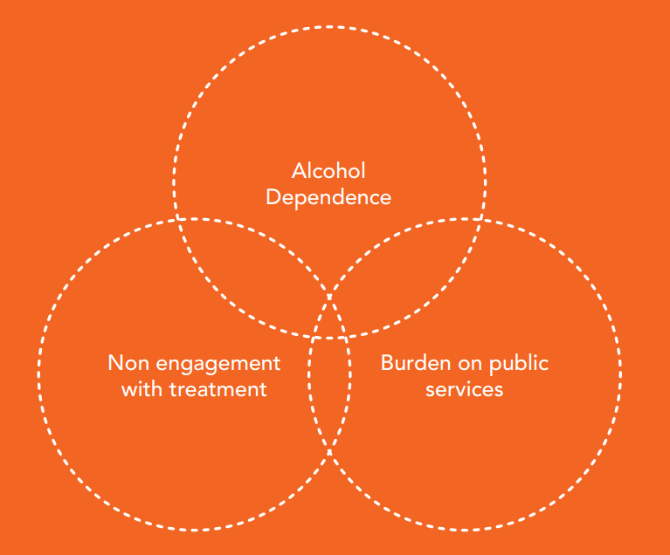
Vulnerable Dependent Drinkers
The Blue Light Project - Alcohol Change UK
20XX
Nov 2019

Slide 5
Impact of High Risk Dependent Drinking
Person
Relationships
Society
Nov 2019

Slide 6
Impact of High Risk Dependent Drinking:
Services
In an area with a population of 200,000, the Blue Light project estimated that there are around 250 Blue Light clients who cost at least £12-13 million each year across a range of agencies:
Emergency Services
Health services
Social Care Services

Slide 7
Learning from SARs
Learning from Tragedies (Alcohol Change UK) – analysis of 11 SARs published in England in 2017 where alcohol was a significant factor
‘Carol’ (Teeside 2018)
Leanne Patterson (Northumberland 2019)
Alan (Sunderland 2021)

Slide 8
Why help if they don’t want to change?
They are often the most risky and vulnerable members of society
So… many of the people society most needs to target, are drinkers who appear not ready to change

Slide 9
‘Lifestyle Choice'
Choosing to drink?
Able to control own behaviours?
Unwise decision making?
or
Is it something else……?
*Professional curiosity*
20XX
Nov 2019

Slide 10
Barriers to change
The real first step on this journey is to understand why this person is not changing...
Brain damage – ARBD, fits, fights and falls
Poor nutrition
Liver disease and other health conditions
Depression and other mental health
Low self esteem
Influence of peers
Not as simple as denial or unwillingness to change… the person is at the centre of a ‘perfect storm’ of conditions which make it harder and harder for them to organise and motivate themselves.
20XX
Nov 2019

Slide 11
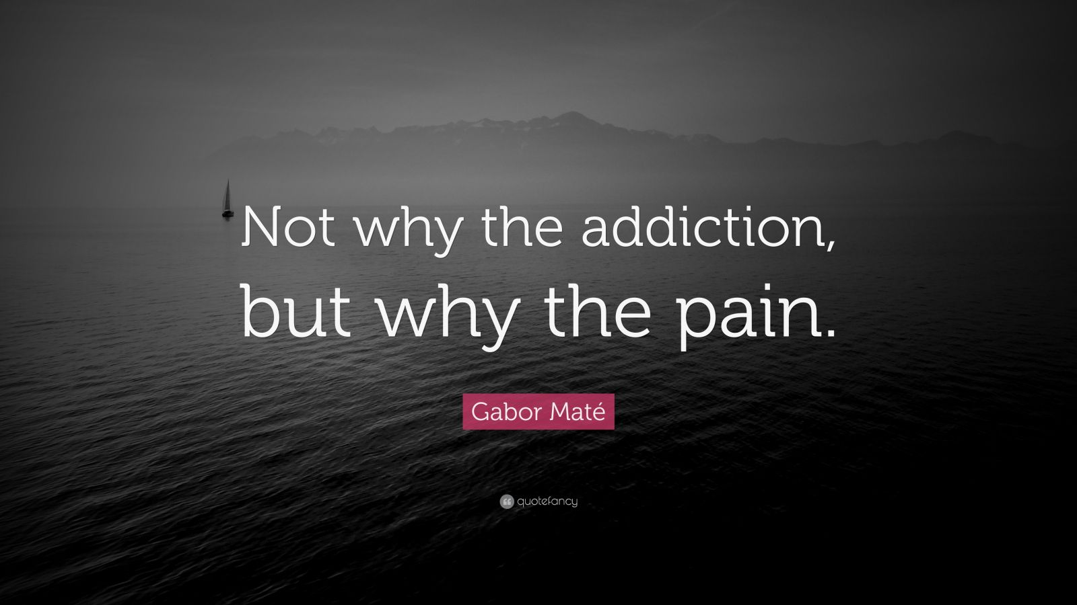

Slide 12
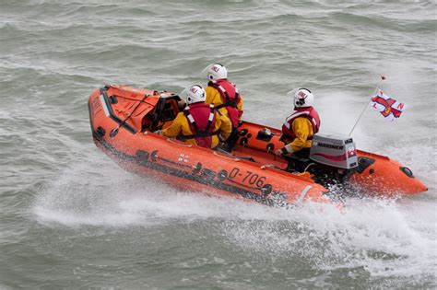
What can we do?
20XX
Nov 2019

Slide 13
What can we do?
Take every opportunity
Not everyone will change or want abstinence
Change is not the only option
Whole system approach
Information sharing
Assertive outreach
Celebrate success
Nov 2019

Slide 14
Safeguarding: s.42 Care Act 2014
Three Tier Threshold:
1/ Has needs for care and support (whether or not the local authority is meeting any of those needs)
And
2/ Is experiencing, or at risk of, abuse or neglect, including self-neglect.
And
3/ As a result of those care and support needs is unable to protect themselves from either the risk of, or the experience of abuse or neglect, including SELF-NEGLECT.
Self neglect covers a wide range of behaviors neglecting to care for one’s personal hygiene, health or surroundings.
20XX
Nov 2019

Slide 15
Making Safeguarding Personal
(Care Act 2014, Statutory Guidance)
An approach to safeguarding that is person-led and outcomes-focussed
Seeing adults as experts in their own lives, and working alongside them to identify the outcomes they want
Achieving meaningful improvements to adult's lives to prevent abuse and neglect occurring in the future, including ways for them to protect themselves and build resilience
Recognising that individuals come with a variety of different preferences, histories and circumstances
Not 'walking away' if a person declines safeguarding support

Slide 16
Principles of Engagement
(Lee Irving SAR, Newcastle 2017)
Find out the best way to communicate with each other
Recognise a person's vulnerability might impact upon engagement
Use the Mental Capacity Act (MCA)
Consider MCA of consequences of non engagement
Identify a lead professional
Don't assume that someone else is dealing with the problem
Be careful what you record around engagement, or lack of
Remember, engagement may fluctuate

Slide 17
Legal Frameworks
Care Act
Mental Capacity Act
Mental Health Act
Human Rights Act

Slide 18
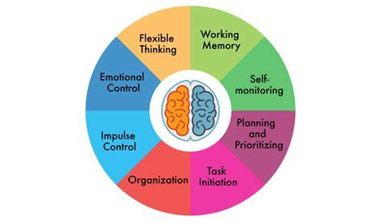
MCA - Executive Function
They can
“talk the talk”
BUT
Can they
“walk the walk”?

Slide 19
We can make a difference…..
Learning from SARs
Blue Light Project
Emerging practice
Person centred working
Using legal frameworks
Potential to SAVE LIVES!

Slide 20
Resources www.alcoholchange.org.uk
Blue Light Manual
Learning from Tragedies
How to Use Legal Powers to Safeguard Highly Vulnerable Dependent Drinkers

Slide 21
Close and Questions

